Slide 1


Blockchain and Cybersecurity: Reinventing Digital Security
by Sathvik Kamegaonkar
In the digital age, blockchain technology is emerging as a powerful solution to reinvent cybersecurity. By leveraging its decentralized, transparent, and secure nature, blockchain is revolutionizing the way we protect our digital assets and data.
Traditional cybersecurity methods have often faced challenges such as centralized control, lack of transparency, and vulnerability to hacking. However, with blockchain, these issues can be addressed as the technology allows for secure and immutable record-keeping, decentralized control, and encryption techniques that enhance data security. As a result, blockchain has the potential to provide a new paradigm for cyber defense and enable a more resilient and trustworthy digital environment.

Slide 2
The Digital Age: Where Cybersecurity Meets Blockchain
Cybersecurity Challenges
Blockchain's Security Features
Convergence of Technologies
Cyberattacks are a growing problem. We need better ways to protect our data and online systems. The digital world is more connected than ever, which makes us vulnerable to attacks. Phishing, ransomware, and data breaches are becoming more common. This means we need stronger security measures to keep our information safe.
Blockchain technology offers new ways to secure and protect data. It's designed to be resistant to attacks because it's decentralized. Information on a blockchain is permanent, so it can't be changed or deleted, making it a trusted record. Blockchain uses strong encryption to keep data safe and private.
Blockchain and cybersecurity can work together to improve digital security. By combining blockchain's strengths with existing systems, we can make data safer, verify identities more securely, and protect supply chains. This combination has the potential to make the internet a safer place for everyone.

Slide 3
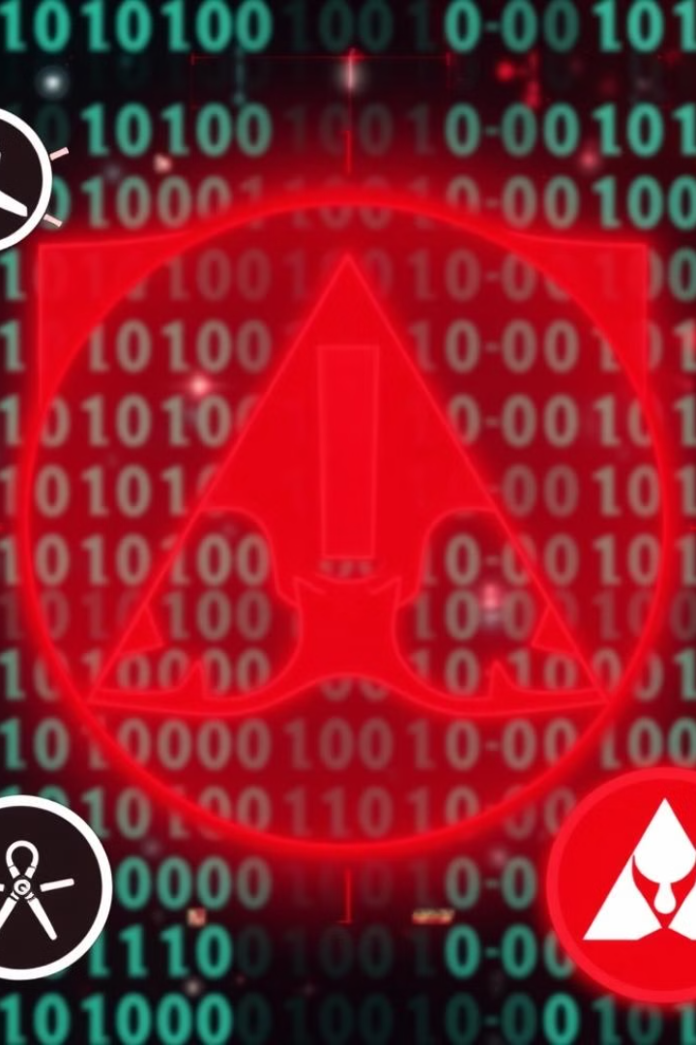
Challenges and Rising Risks in Modern Cybersecurity
1
Sophisticated Cyber Threats
2
Increased Attack Surface
The proliferation of connected devices, cloud computing, and the Internet of Things (IoT) expands the attack surface.
Cybercriminals, nation-state actors, and advanced persistent threats (APTs) continuously evolve their tactics.
3
Regulatory Compliance Challenges
4
Insider Threats and Vulnerabilities
Organizations struggle to keep up with evolving data privacy and security regulations.
Malicious insiders and unintentional human errors pose significant risks to data security.

Slide 4

Decentralized, Transparent, and Secure: The Power of Blockchain
Decentralization
Transparency
Blockchain's distributed ledger technology eliminates single points of failure, improving resilience against cyber attacks.
Blockchain's immutable and transparent nature provides auditable records of all transactions and data changes.
Cryptographic Security
Smart Contracts
Blockchain leverages advanced cryptography to ensure the integrity and confidentiality of data and transactions.
Blockchain-based smart contracts automate secure processes and reduce the risk of human error.

Slide 5
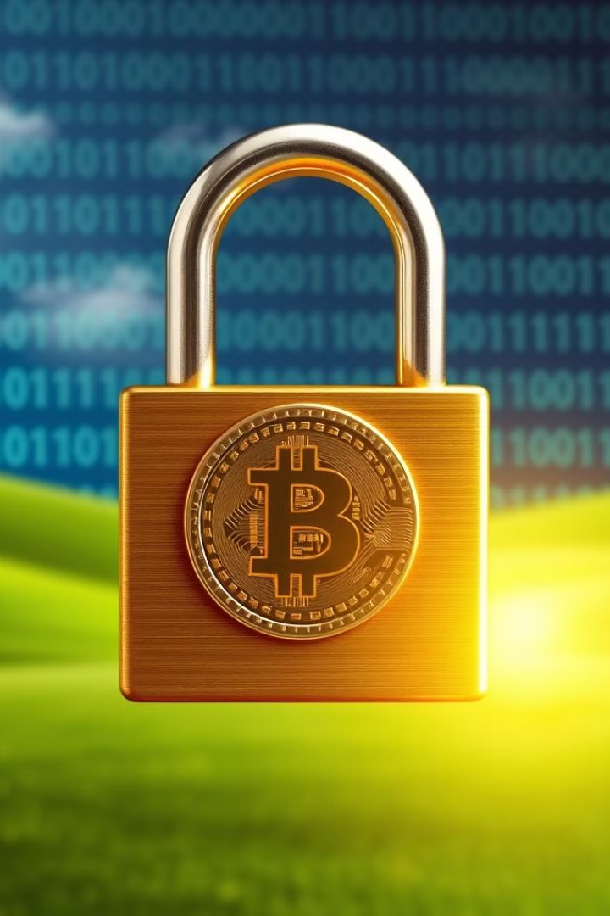




How Blockchain Solves Cybersecurity Issues
Data Integrity
Distributed Security
Blockchain's immutable ledger ensures that data cannot be altered or tampered with.
The decentralized nature of blockchain networks makes them resilient to single points of failure.
Cryptographic Protection
Automated Processes
Advanced cryptographic algorithms used in blockchain provide robust data encryption and authentication.
Blockchain-based smart contracts can automate security-critical processes and reduce human error.

Slide 6

Real-World Applications of Blockchain in Cybersecurity
1
Identity Management
Blockchain-based identity solutions enhance security and privacy by providing decentralized, tamper-proof digital identities.
2
Supply Chain Traceability
Blockchain enables end-to-end traceability and transparency in supply chains, mitigating the risk of counterfeit goods and tampering.
3
Data Sharing and Access Control
Blockchain can facilitate secure and auditable data sharing, with granular access controls and permissions.

Slide 7
IBM Food Trust Blockchain: Ensuring Transparency and Safety in the Food Supply Chain
Traceability and Transparency
Improved Food Safety
Enhanced Supply Chain Efficiency
IBM Food Trust uses blockchain to track food products from farm to table, giving consumers full visibility into their food's journey. Every step is recorded on the blockchain, creating a permanent, secure record.
Blockchain quickly identifies the source of contamination, reducing the time and cost of food recalls. In the event of a food safety incident, blockchain technology allows for rapid tracing of affected products, enabling swift action to prevent widespread contamination and minimize consumer harm.
Blockchain facilitates data sharing and collaboration, improving supply chain coordination and efficiency. Streamlined communication and information flow through blockchain enables seamless interactions between all stakeholders. This leads to cost savings, reduced waste, and a more sustainable food supply chain.

Slide 8
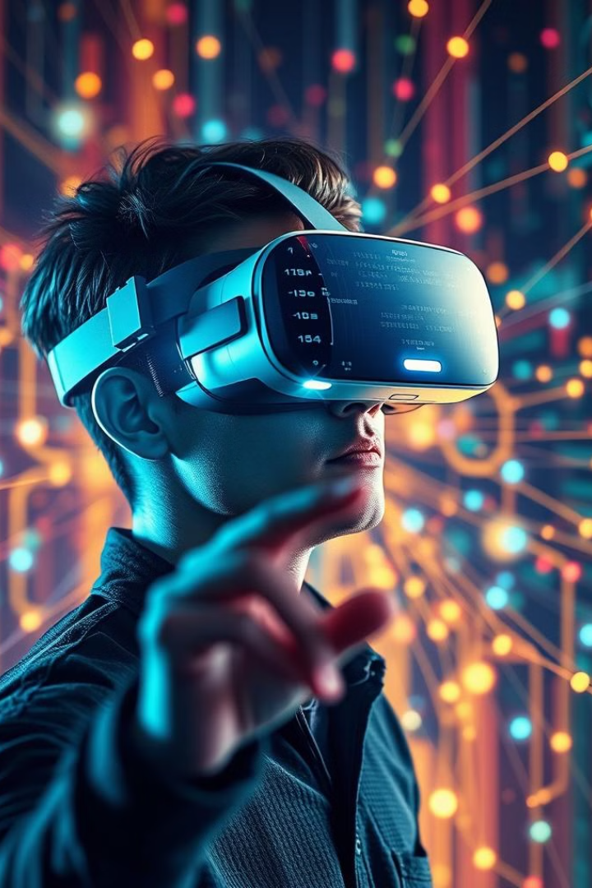



Blockchain in Action: An Interactive Demo
Initiate Transaction
Begin a secure transaction on the blockchain network.
Validate and Record
The transaction is validated and recorded on the distributed ledger.
Transparency and Traceability
All participants can view the transaction history and track the asset's journey.

Slide 9
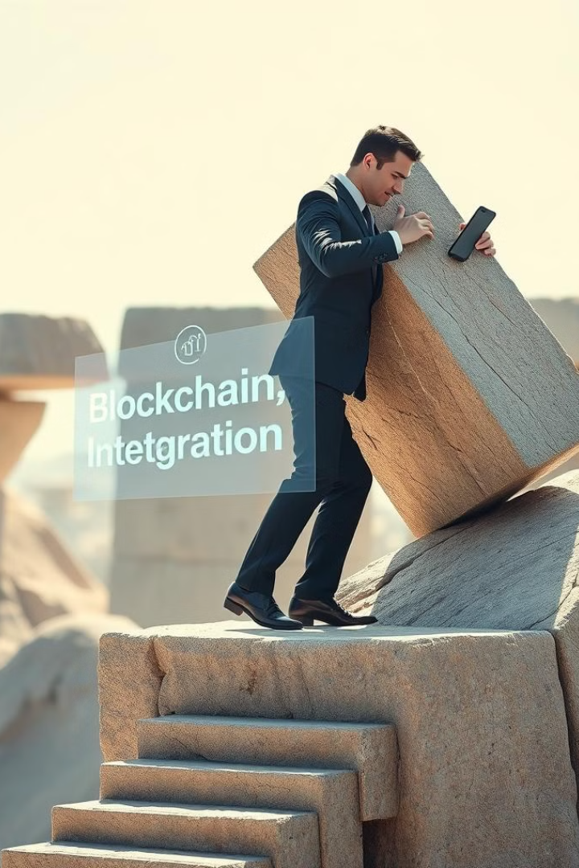
Challenges in Blockchain Adoption for Cybersecurity
1
Scalability Limitations
2
Regulatory Uncertainty
Blockchain networks may struggle to handle high transaction volumes and processing speeds required for enterprise-level applications.
Lack of clear regulatory guidelines and standards can hinder the widespread adoption of blockchain in cybersecurity.
3
Integration Complexities
Seamlessly integrating blockchain with existing IT infrastructure and legacy systems can pose significant technical challenges.

Slide 10

The Future of Blockchain in Cybersecurity
AI-Powered Blockchain
Quantum-Resistant Blockchain
Blockchain-Secured IoT
The integration of artificial intelligence (AI) will enhance blockchain's ability to detect and respond to cyber threats.
Advancements in quantum computing will drive the development of blockchain networks resistant to quantum attacks.
Blockchain will play a crucial role in securing the growing ecosystem of interconnected devices in the Internet of Things (IoT).

Slide 11

Thank You
We hope this presentation has provided you with a comprehensive overview of how blockchain technology can revolutionize cybersecurity. Thank you for your time and attention today.

